Slide 1
USI & SUPSI Source Code Management (SCM)
Finiletti Simone, Beffa Bryan

Slide 2
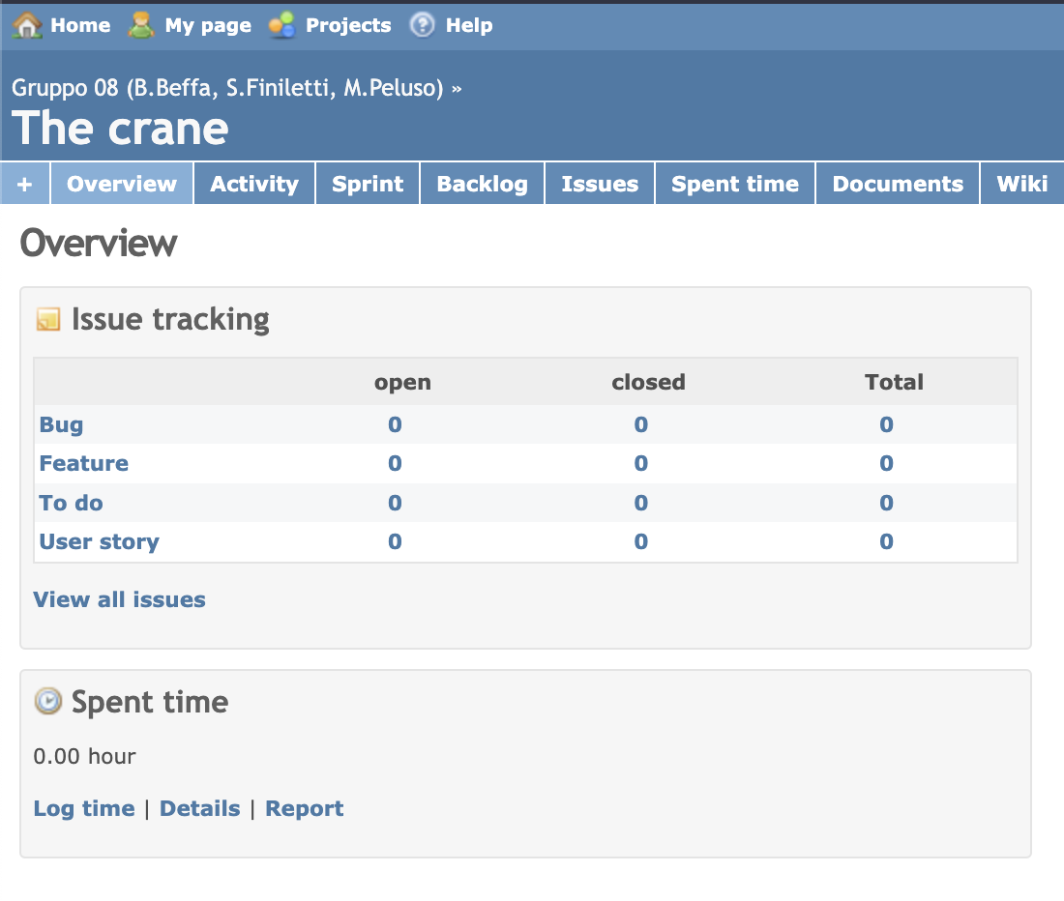
Project overview
The product:
This website offers to USI & SUPSI students and collaborators a way to work on repositories and manage other project operations.
Project duration:
December 2022

Slide 3
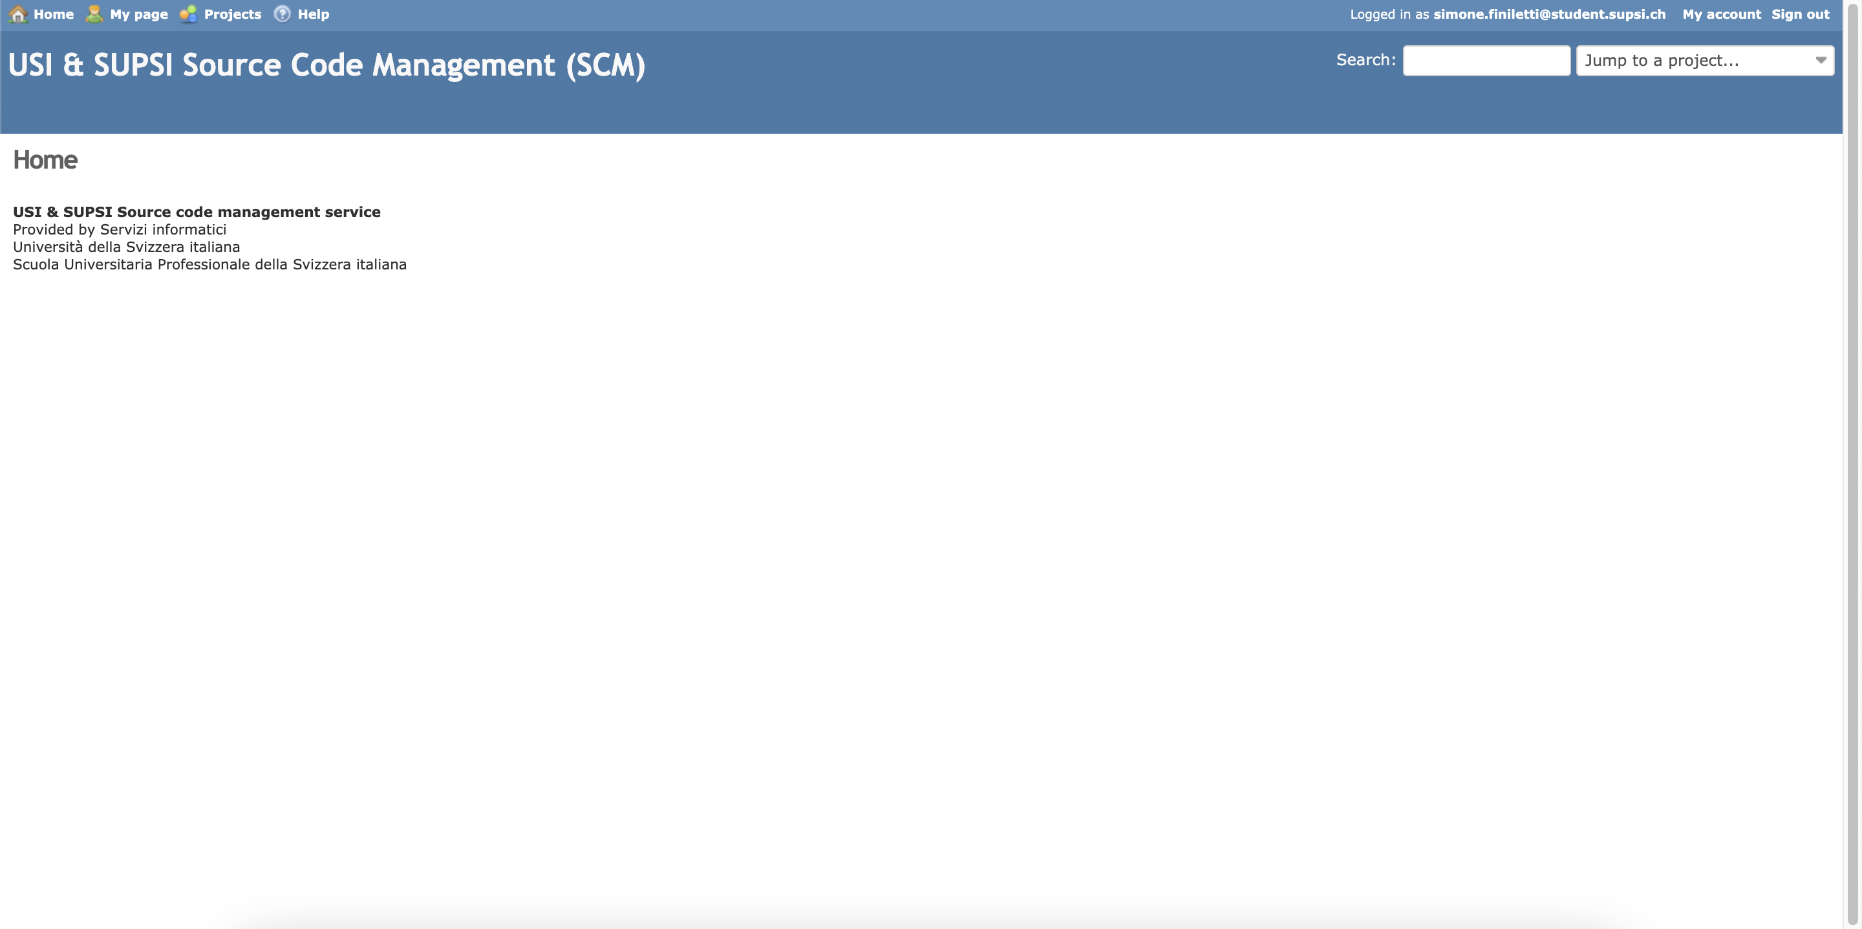

Slide 4
Project overview
The problem:
Low usability, Mediocre Intuitivity and Bad design
The goal:
Refactor website appearance and add new useful functionalities grouping them in appropriate pages.

Slide 5
Methods
Questions
Qualitative results
Quantitative results
Understanding
the user

Slide 6
User research: summary
We asked SCM users to describe the major difficulties they found in its use. We interviewed some students taking the computer engineering course.
We asked them to specify which features are missing and how much they like or dislike the organization of the pages.

Slide 7
User research: method
1
2
3
4
Question 1
Question 2
Question 3
Question 4
Describe how you feel about the appearance of the website.
Do you find it easy to reach your project repository overview? Yes/Almost/No
Do you think it’s easy for a new user to familiarize with the usage of the website? Yes/Almost/No
Which functionalities would you have ready-to-use once you log into SCM?

Slide 8
Quantitative results
Users find it generally easy to reach the repository overview page, but some experience is needed

Slide 9
Quantitative results
Users think that it’s not that easy for new users to familiarize with SCM.

Slide 10
Qualitative results
Users criticize the appearance of the website because they think that it is to careless to be a University Website and it’s to little intuitive. The general appearance (colors, disposition, ecc) feels obsolete and could need a refactor.
Users defined that SCM has all the functionalities but not all of them are easy to access. Expecially for new users, it’s hard to reach the information they need.

Slide 11
Defining
the user
archetype
Personas
Empathy maps
User stories

Slide 12
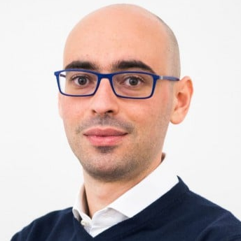
Persona 1
“Researcher that is an everyday user of SCM”
Goals
He wants to have the biggest number of repository managing features possible on SCM.
Frustrations
Want the website to be update to newer appearence standards
Christian
Age:
Education:
Hometown: Occupation:
34
IT Engineer
Lugano
Researcher
Christian is an everyday user of SCM and he likes that there are many features available on it. He has a lot of experience with the website but he may like a User Experience update.

Slide 13
Persona 1
SCM has a lot of features
The website is fine beacuse he knows it very well
User
Use the website every day to work and study
Comfortable with the website

Slide 14
Persona 2
“Relevant personal quote that captures the persona’s attitude and personality”
Add image that represents this persona
Goals
The related objectives this person wants to successfully complete
Frustrations
The issues or pain points that they encounter or try to avoid
Name
Age:
Education:
Hometown:
Family:
Occupation:
Brief story or scenario that conveys the persona’s user journey, highlighting their goals, frustrations, and other relevant context.

Slide 15
Persona 2
User

Slide 16
Persona 3
“Relevant personal quote that captures the persona’s attitude and personality”
Add image that represents this persona
Goals
The related objectives this person wants to successfully complete
Frustrations
The issues or pain points that they encounter or try to avoid
Name
Age:
Education:
Hometown:
Family:
Occupation:
Brief story or scenario that conveys the persona’s user journey, highlighting their goals, frustrations, and other relevant context.

Slide 17
Persona 3
User

Slide 18
User journey map
[Your notes about goals and thought process]
Image of user journey map

Slide 19
User research: pain points
1
2
3
4
Pain point
Pain point
Pain point
Pain point
Not intuitive for all to access to projects and repositories.
The feature of cloning a repo in not easily available.
The appearance of the website its outdated.
Home page is useless.

Slide 20
Paper wireframes
Digital wireframes
Low-fidelity prototype
Usability studies
Starting
the design

Slide 21
Paper wireframes
[Your notes about goals and thought process]
Image of paper wireframes including five different versions of the same screen and one image of the new, refined version

Slide 22
Paper wireframes
[Your notes about goals and thought process]
Image of paper wireframes including five different versions of the same screen and one image of the new, refined version

Slide 23
Paper wireframes
[Your notes about goals and thought process]
Image of paper wireframes including five different versions of the same screen and one image of the new, refined version

Slide 24
Digital wireframes
Description of the element and its benefit to the user
[Your notes about goals and thought process]
Insert first wireframe example that demonstrates design thinking aligned with user research
Description of the element and its benefit to the user

Slide 25
Digital wireframes
Description of the element and its benefit to the user
[Your notes about goals and thought process]
Insert second wireframe example that demonstrates design thinking aligned with user research
Description of the element and its benefit to the user

Slide 26
Low-fidelity prototype
[Link to low-fidelity prototype and brief description of the user flow]
Screenshot of prototype with connections or prototype GIF

Slide 27
Accessibility considerations
1
2
3
Insert one to two sentence summaries describing each accessibility consideration applied in your designs.
Insert one to two sentence summaries describing each accessibility consideration applied in your designs.
Insert one to two sentence summaries describing each accessibility consideration applied in your designs.

Slide 28
Usability test: participants, setting, materials
Write information about:
Who was involved in the test
Where was the test taken
Which tasks have been proposed to the participants

Slide 29
Usability test: findings
Write an introduction of your findings.
Findings
1
Insert finding
2
Insert finding
3
Insert finding

Slide 30
Mockups
Before usability study
After usability study
[Your notes about goals and thought process]
Image of selected screen before usability study
Image of selected screen after usability study

Slide 31
Mockups
Before usability study
After usability study
[Your notes about goals and thought process]
Image of selected screen before usability study
Image of selected screen after usability study

Slide 32
Mockups
Main mockup screen for display
Main mockup screen for display
Main mockup screen for display
Main mockup screen for display

Slide 33
High-fidelity prototype
[Link to high-fidelity prototype]
Screenshot of prototype with connections or prototype GIF

Slide 34
Going forward
Takeaways
Next steps

Slide 35
Takeaways
Impact:
Insert one to two sentences summarizing the impact of your designs. In the real world, you’d include data like number of downloads or sign ups, but since this is a course project, you can include a positive quote from a peer or study participant.
What I learned:
Insert a few sentences summarizing what you learned throughout the project.

Slide 36
Next steps
1
2
3
Insert a few sentences summarizing the next steps you would take with this project and why.
Insert a few sentences summarizing the next steps you would take with this project and why.
Insert a few sentences summarizing the next steps you would take with this project and why.

Slide 37
Thank you!

